Slide 1
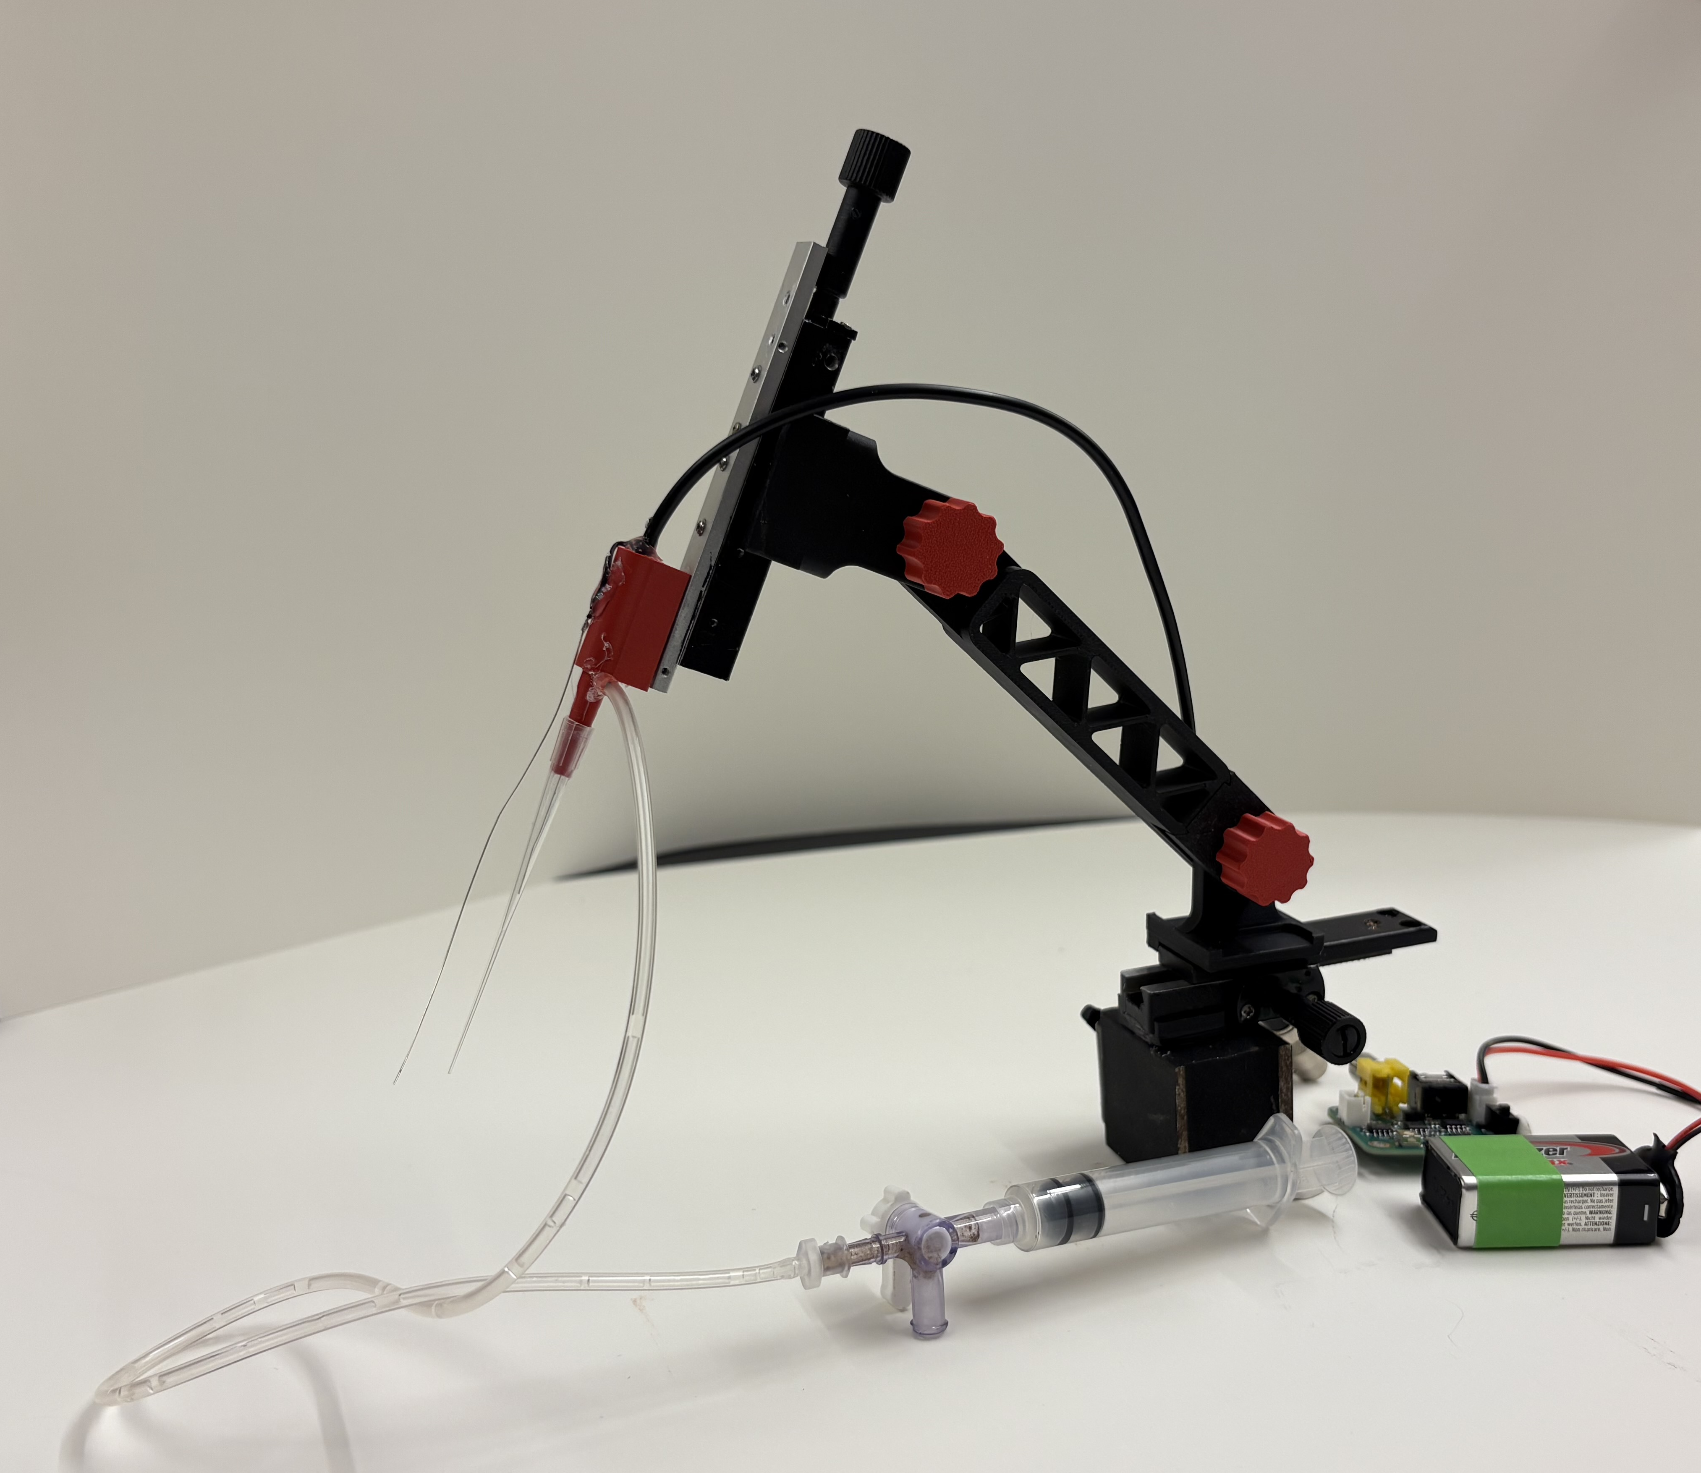
Building the Boom Arm Extracellular Electrode Holder
Designed by Dr. James Ryan for the CrawFly Collective

Slide 2
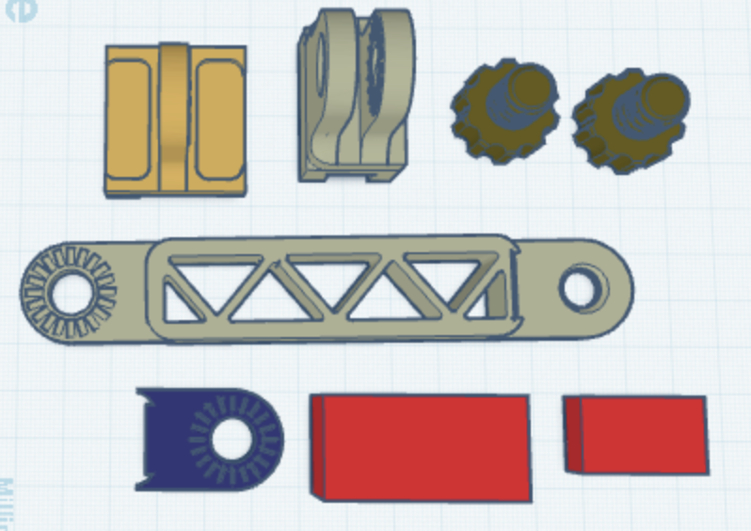
Step 1: 3D print the parts for the boom arm
Parts A, B, C must be printed with supports
Parts should be printed with at least 50% infill for strength and rigidity
The two screws (F) should be printed at 100% infill.
F
F
A
B
.stl files for the parts are available on our GitHib at:
https://github.com/CrawFly/DIY-Neuroscience
C
E
G
D

Slide 3
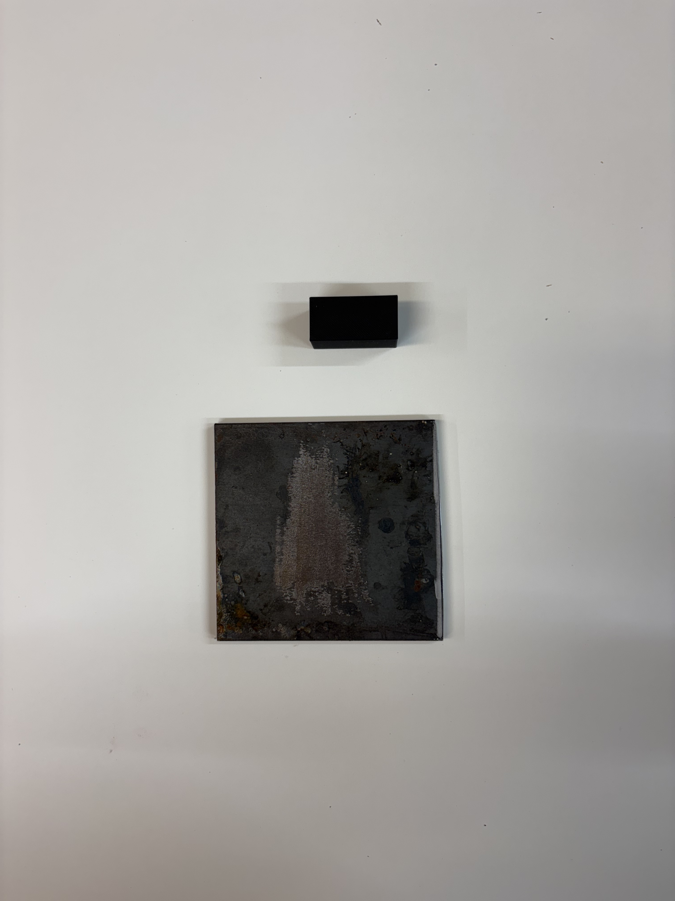
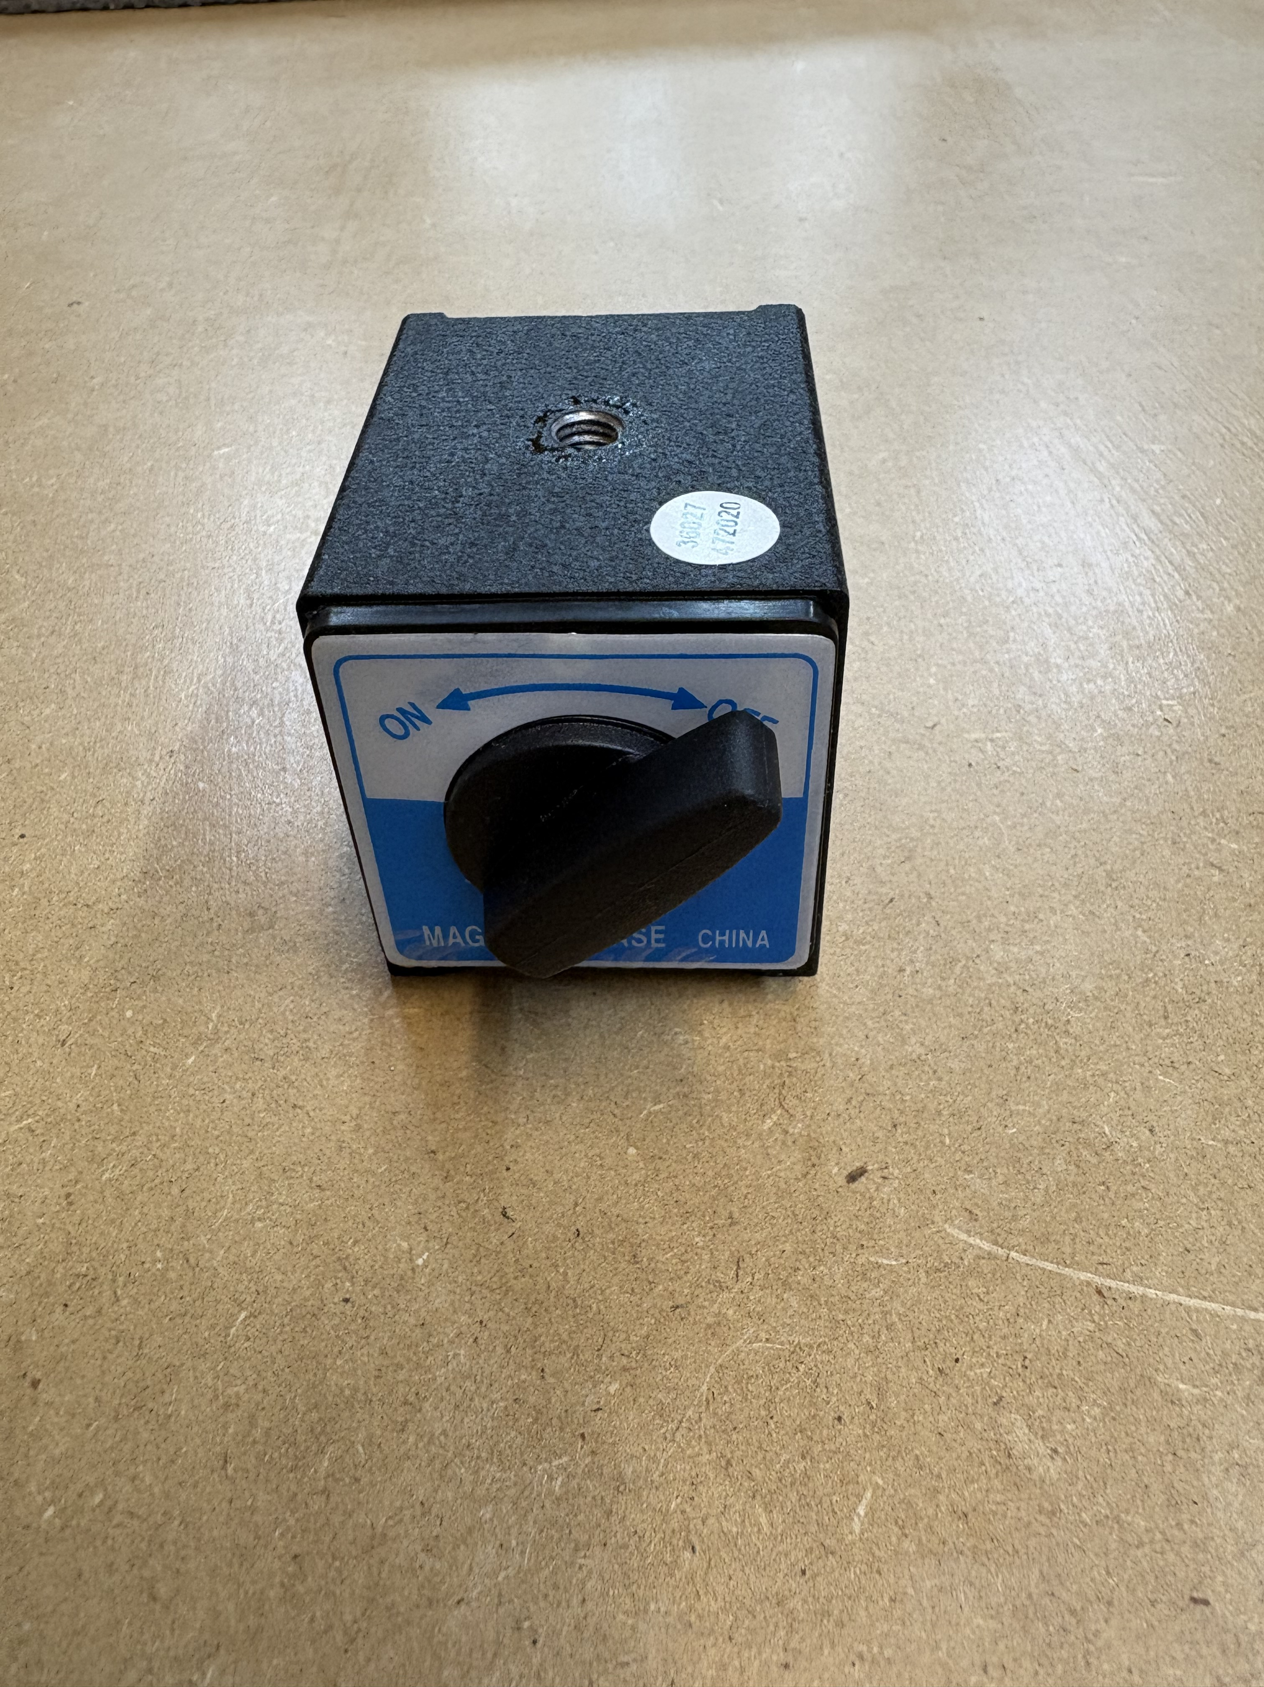
Step 2: Prepare the base.
There are two options for bases:
1) A 4x4 inch sheet of 1/8th or ¼ inch steel plate. Available at Lowes or Home Depot
2) An On-Off magnetic base (used if you have a steel table).
1
Can be purchased from Harbor Freight for ~$13.00 US
2

Slide 4
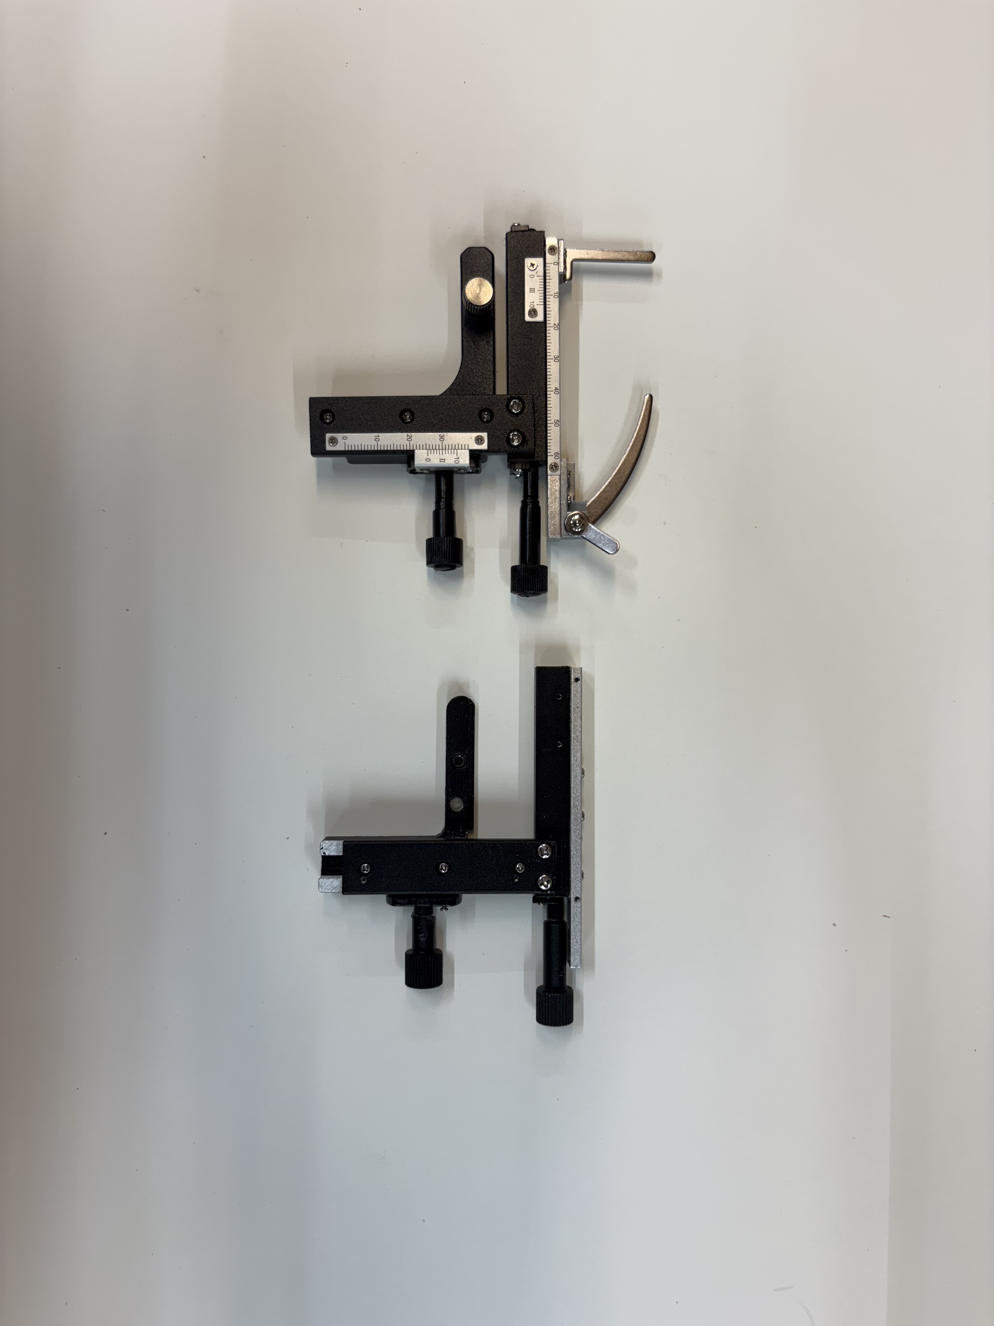
Step 3: Superglue 3d printed part E to the center of either the steel plate or the top of the magnetic base.
Step 4: Prepare the two x-y microscope stages
Begin by removing the slide holders from the top and the scales from the top and bottom sections as shown on the right

Slide 5
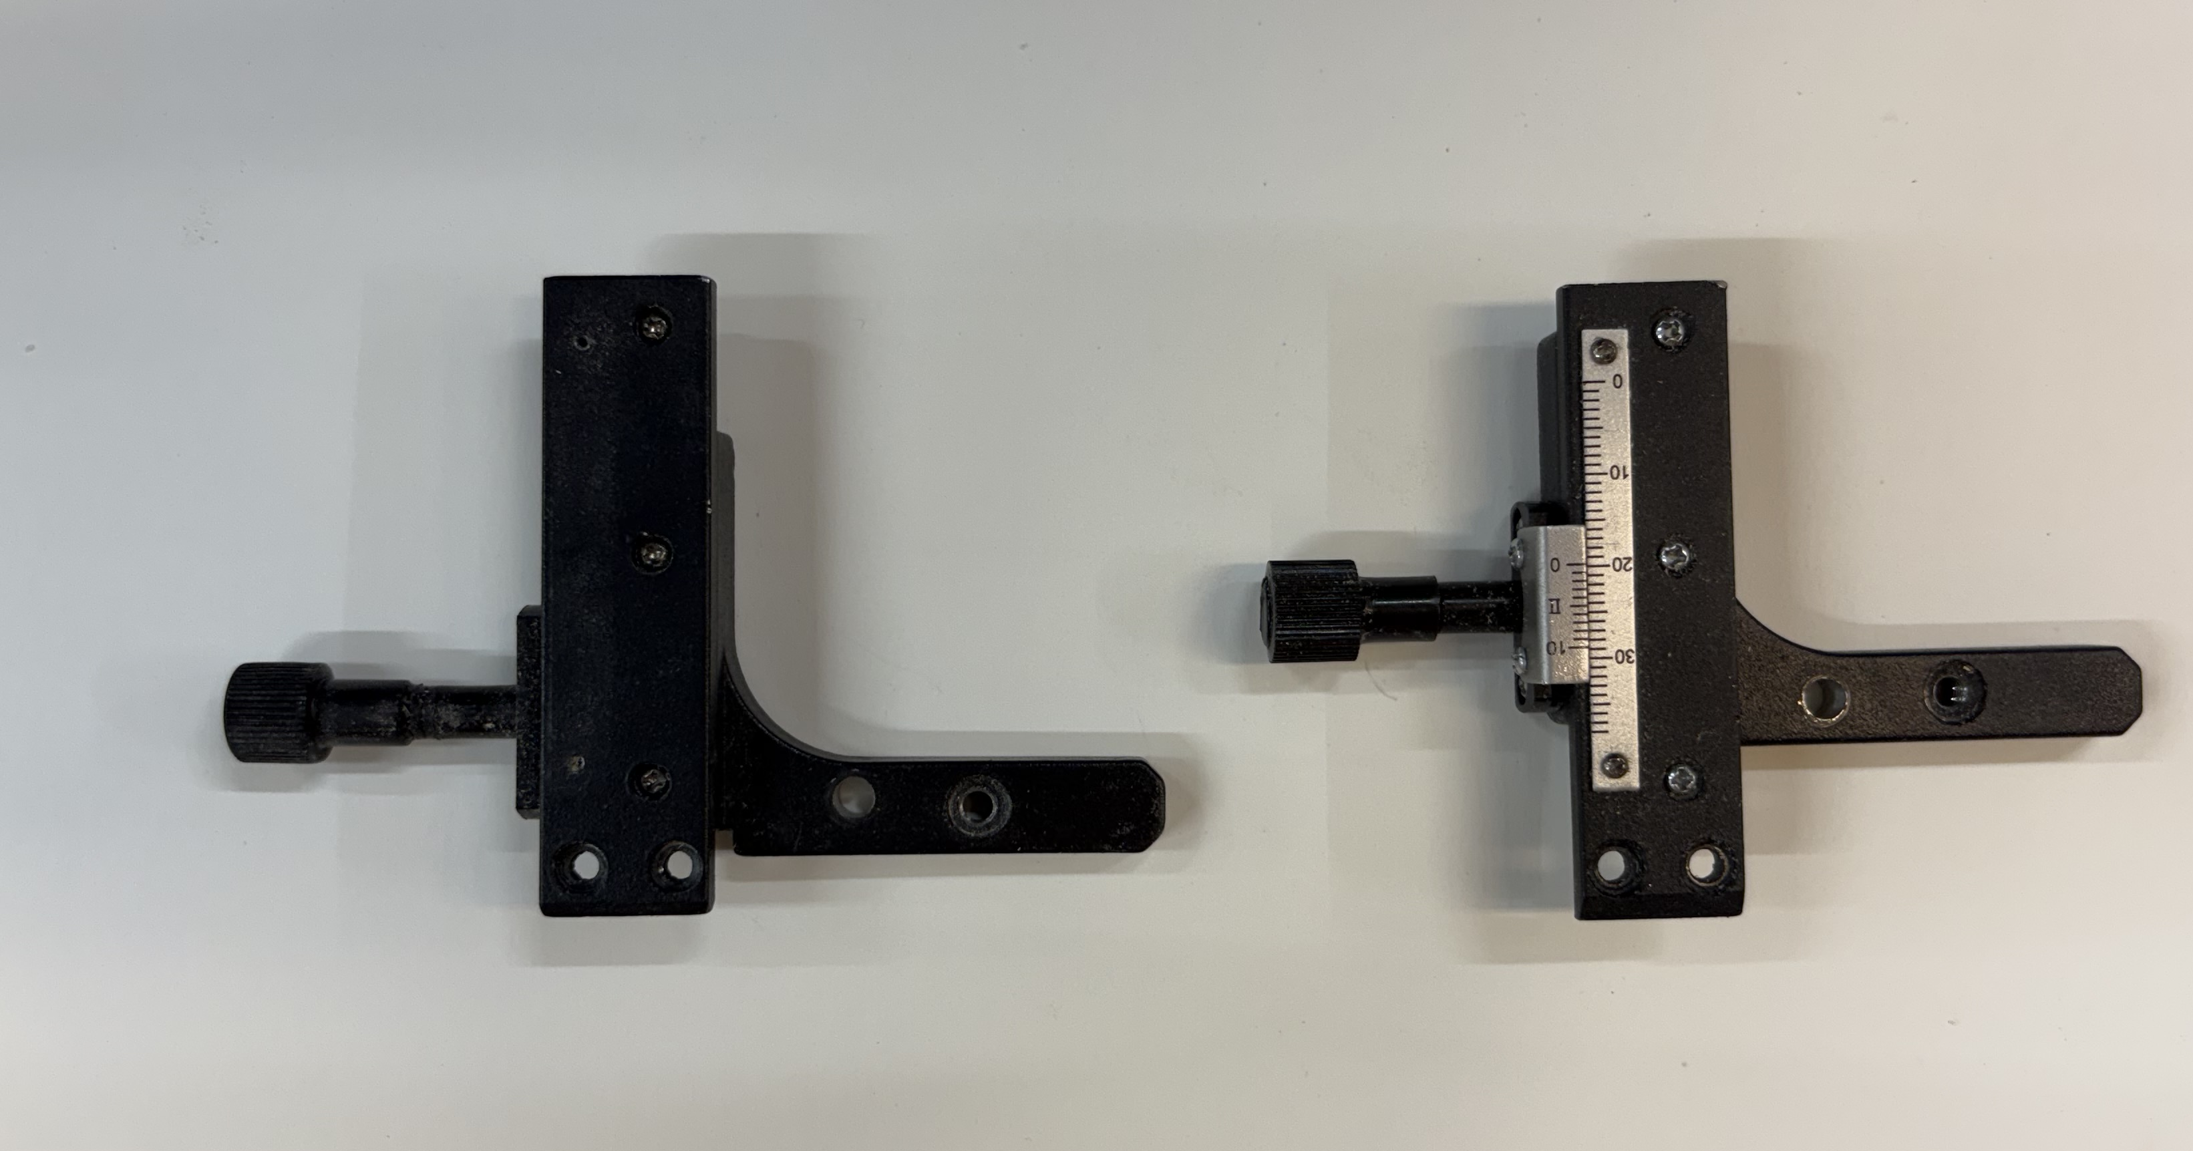
Step 5: Remove the x axis from the y axis by removing the two sliver screws
At this point you should have 2 x-axis parts that look like the one on the right in this photo.
You should also have 2 of the y-axis components (used later).

Slide 6
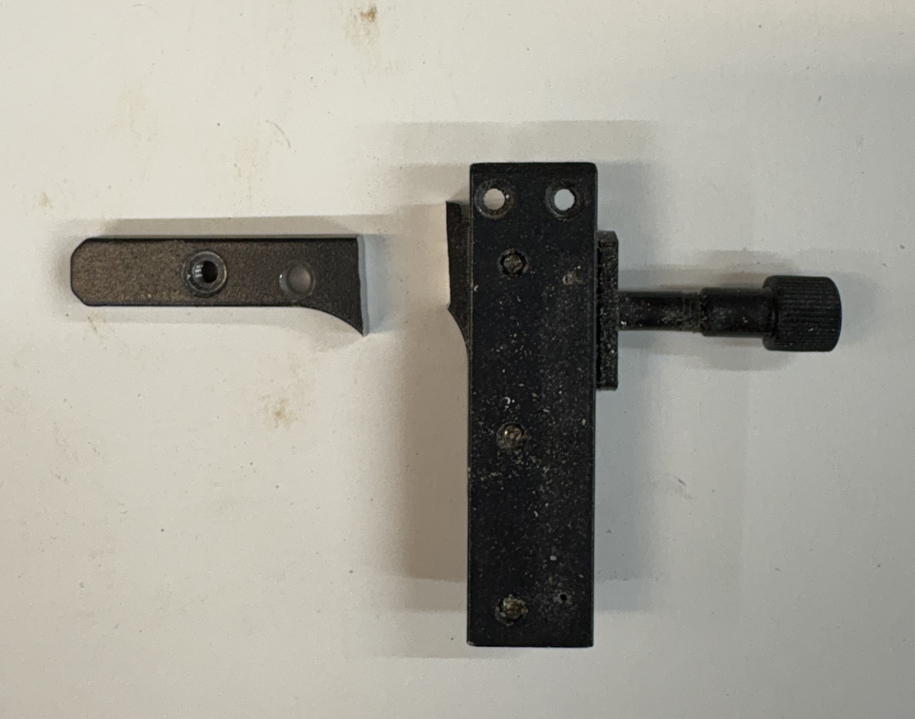
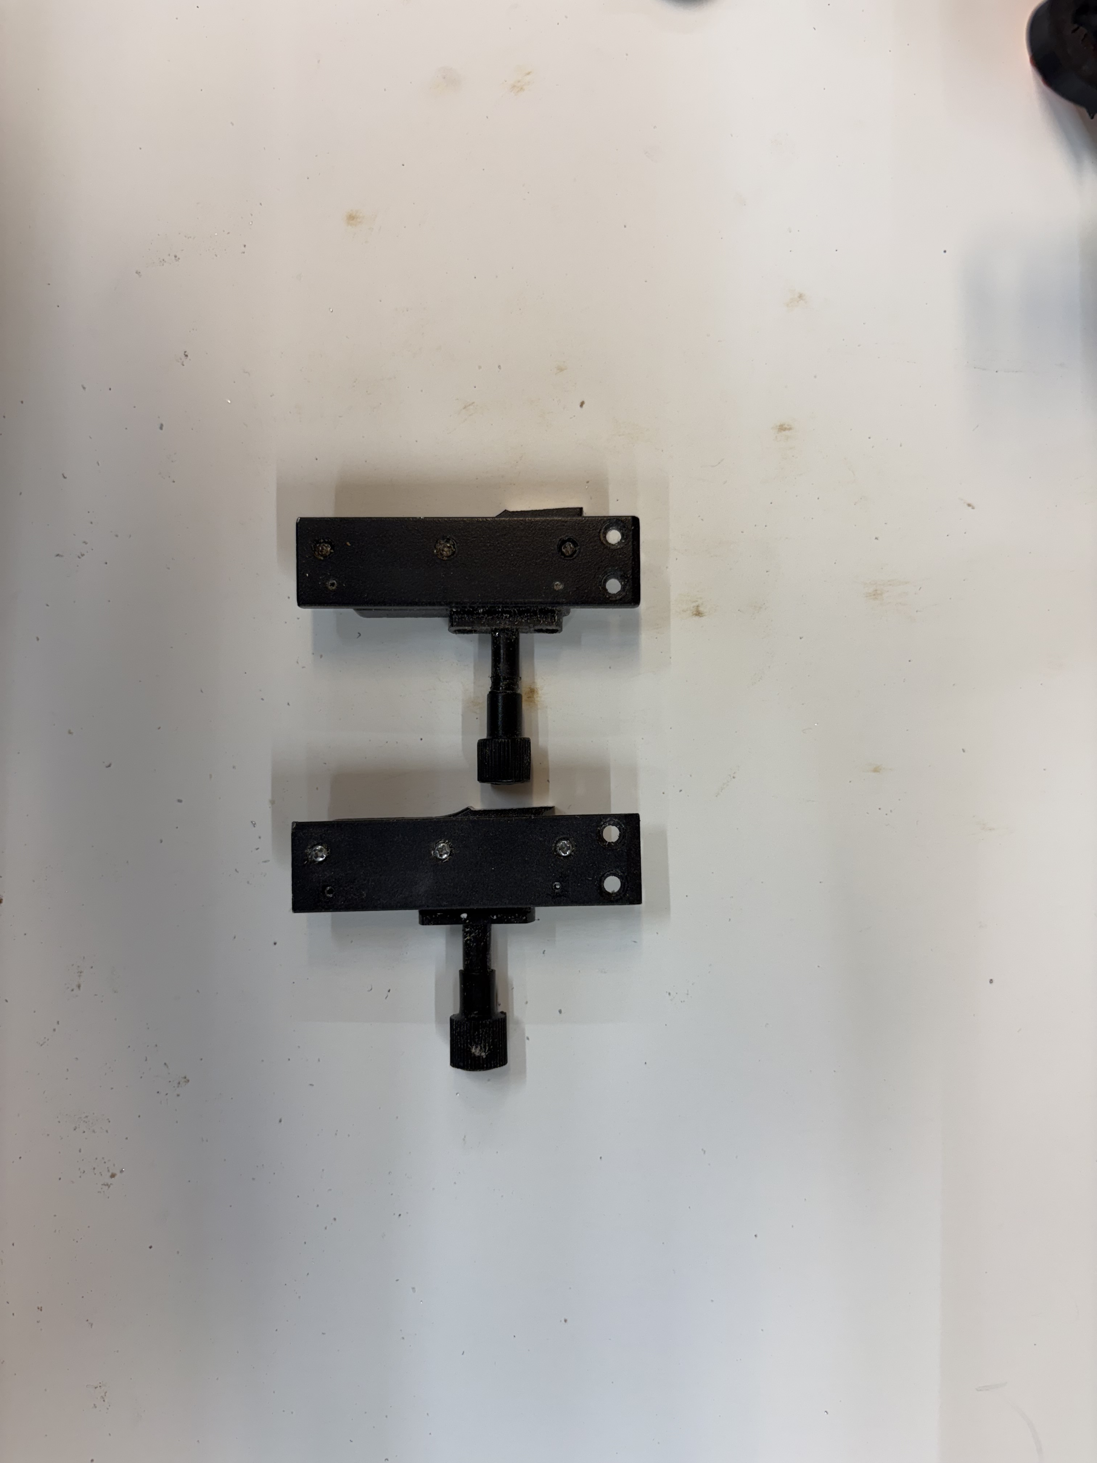
Step 6: Using a hacksaw or band saw, cut the left side of the x-axis off as shown in the photo.
Repeat this process for both x-axis components

Slide 7
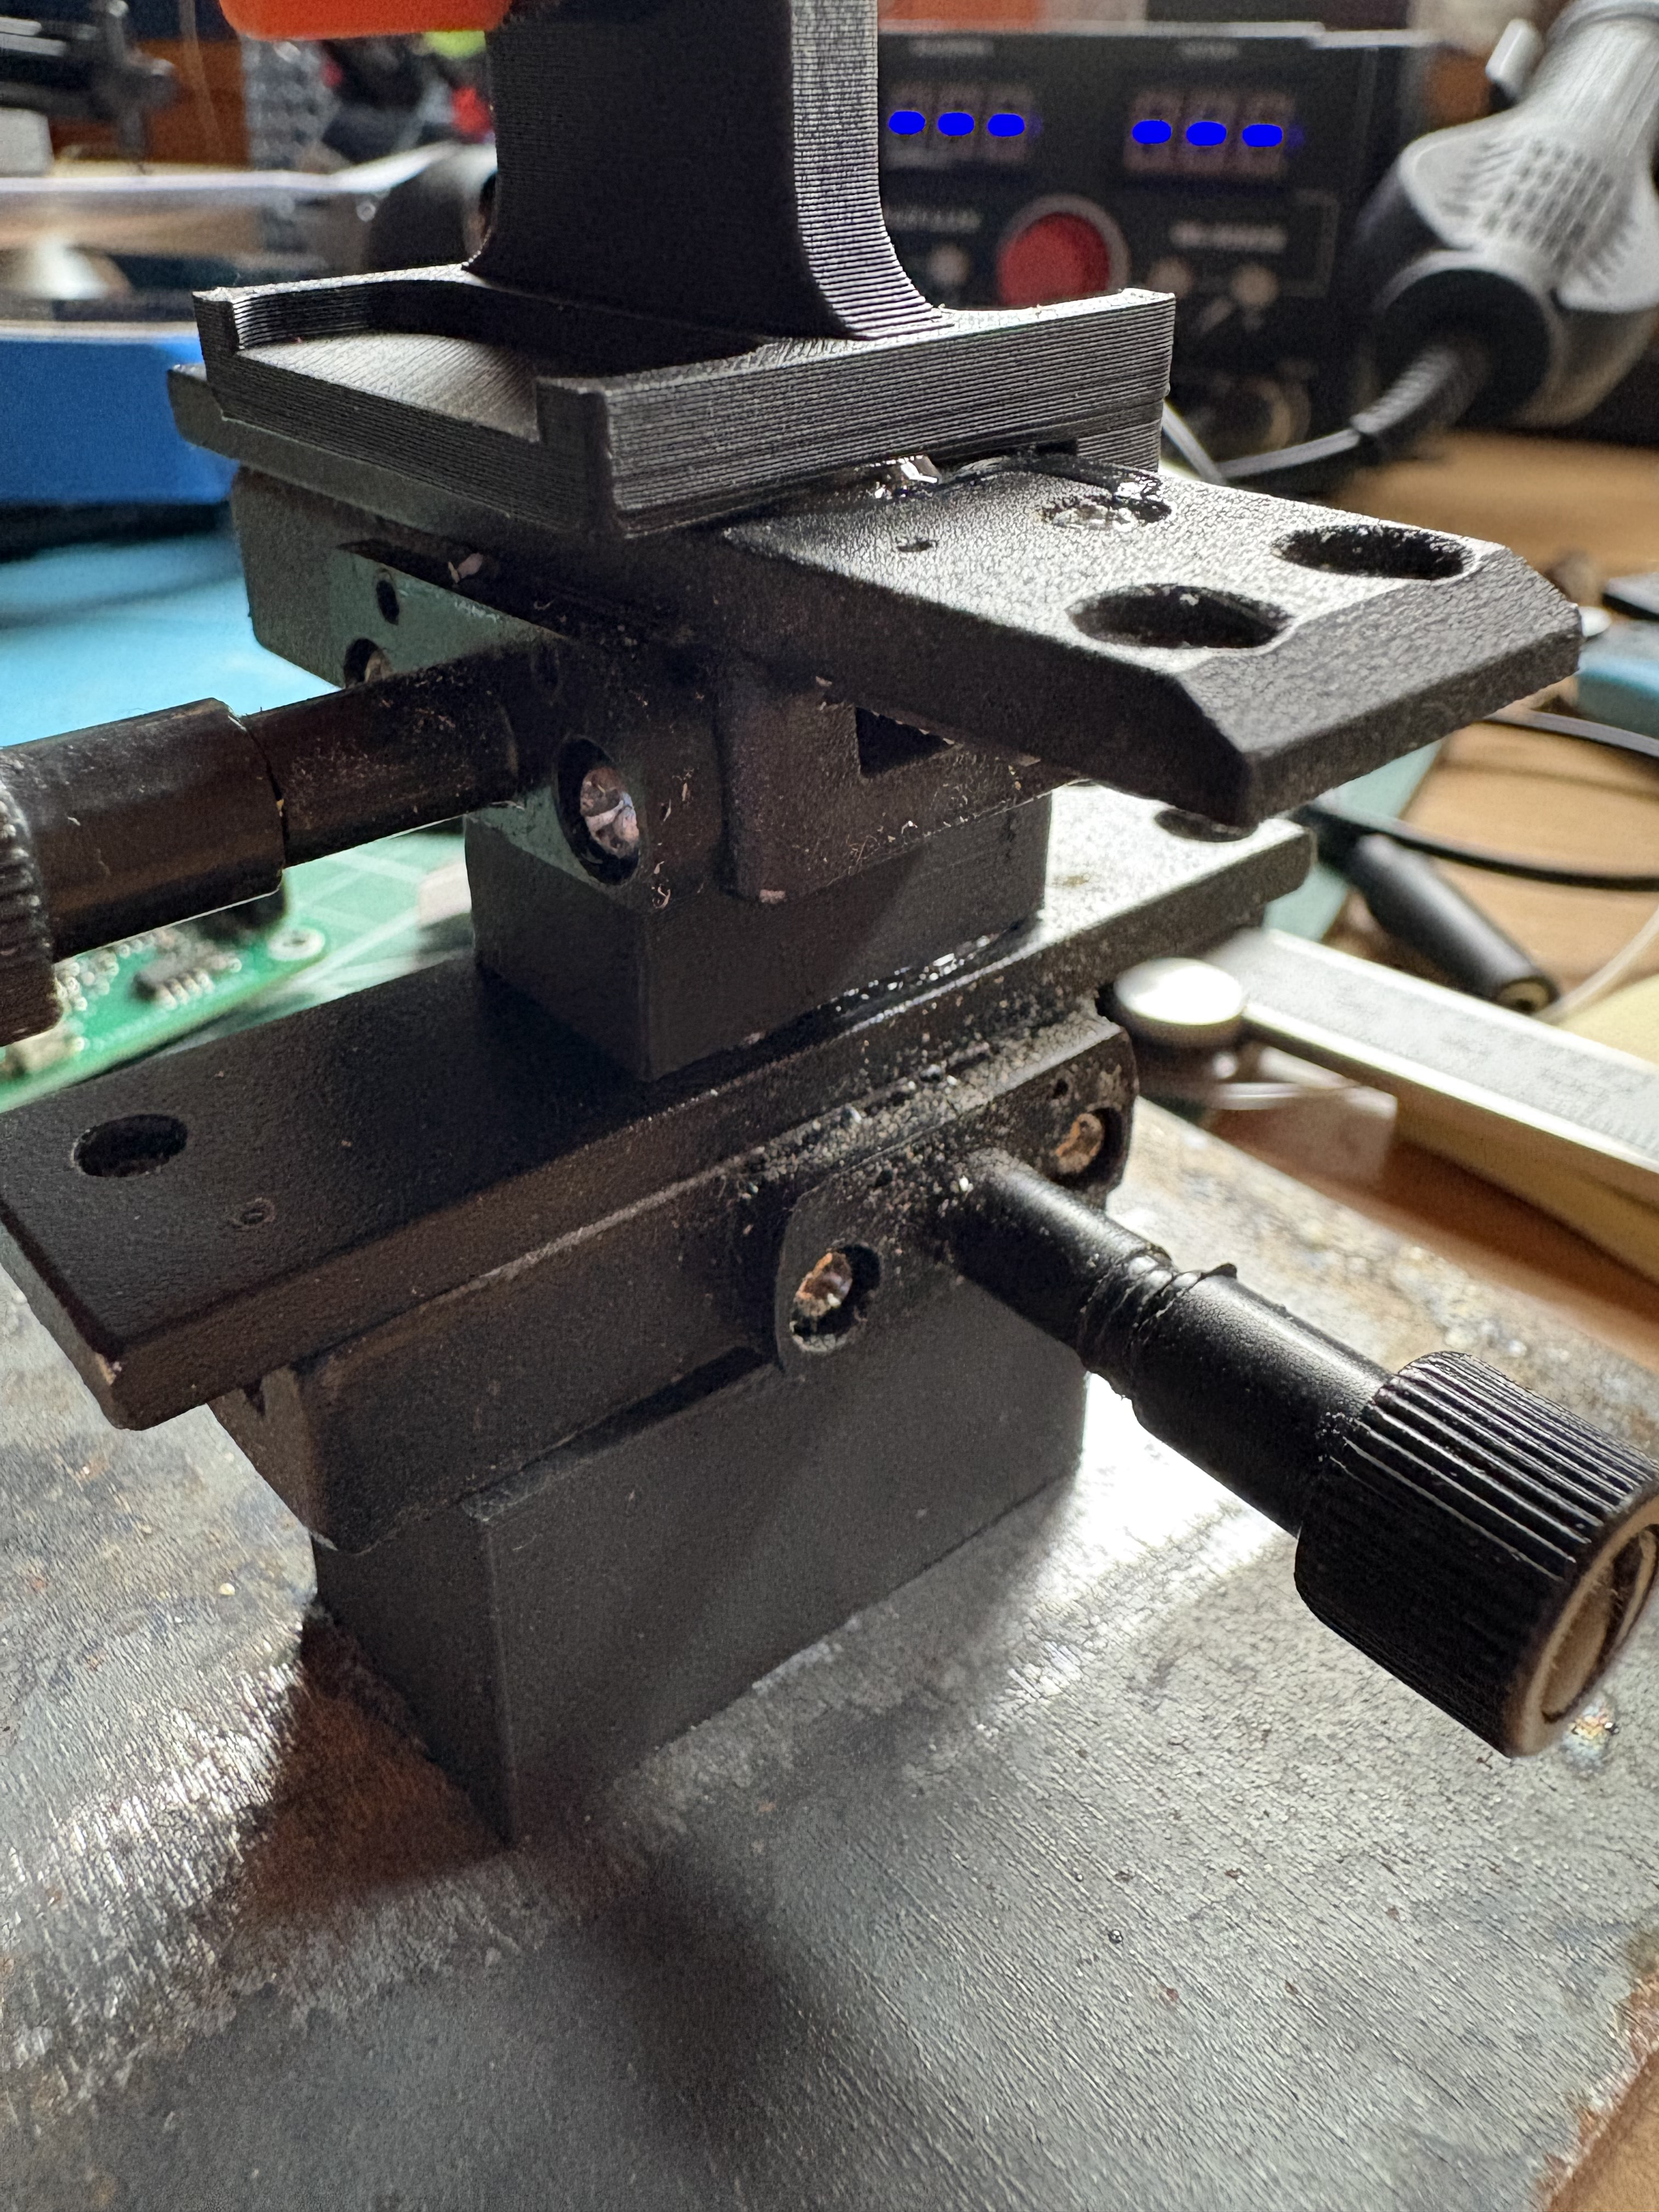
Step 7: Use superglue or epoxy to glue 3D printed part E to the center of the base (either the metal plate or the magnetic base).
Step 8: Glue X-axis 1 to the top of block E keeping it in line with the long axis of block E
Step 9: Glue part G to the top of one of the x-axis components. It should be in line with the x-axis component. Be sure not to get glue into the moveable parts of the x-axis.
X-axis 2
G
X-axis 1
Step 10: Glue x-axis 2 to part G so that the thumb screws are 90 degrees to x-axis 1 (see photo).
E

Slide 8
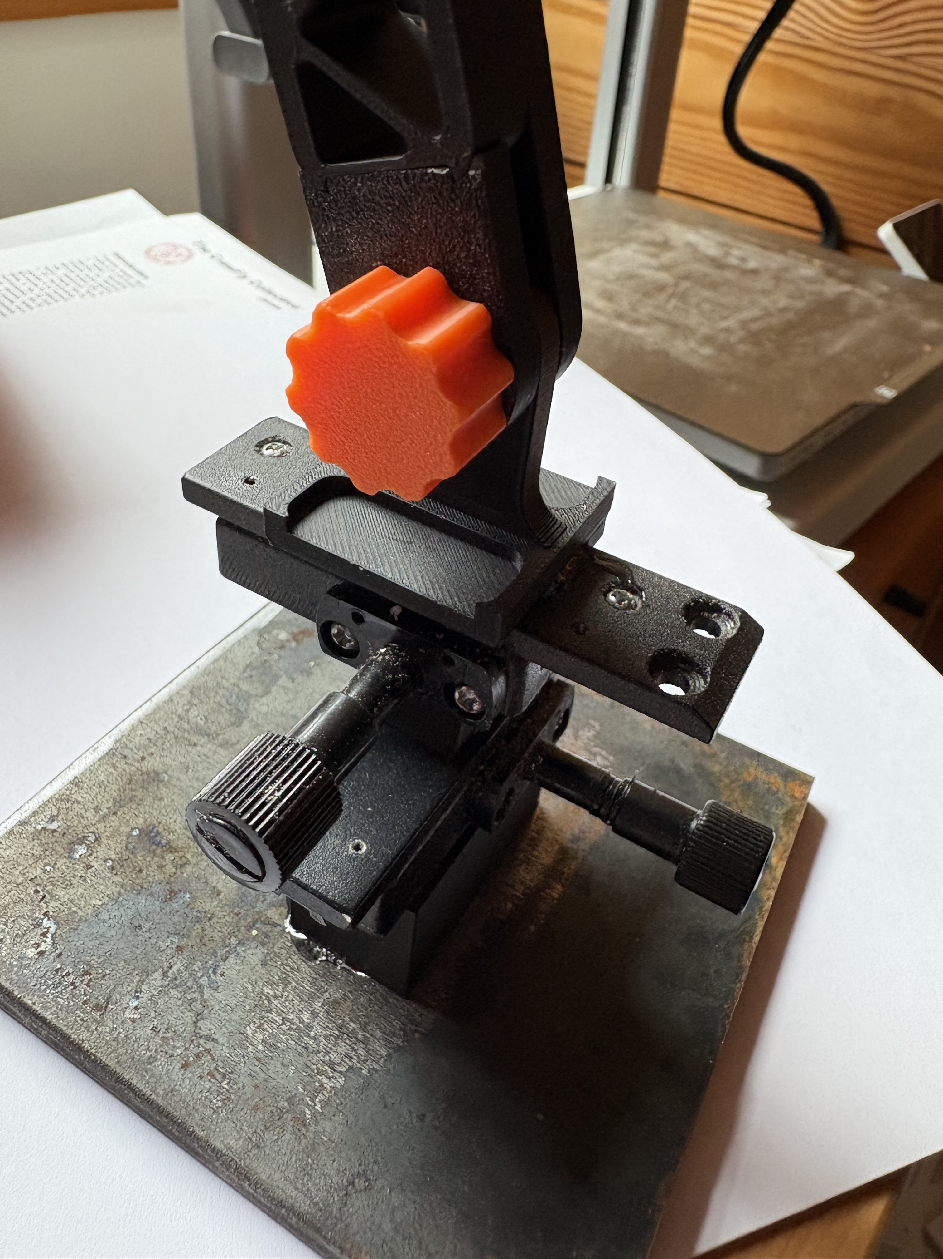
Step 10: Glue 3D printed part A on top of x-axis 2. The center post with the hole should be in line with the x-axis component
Part A

Slide 9
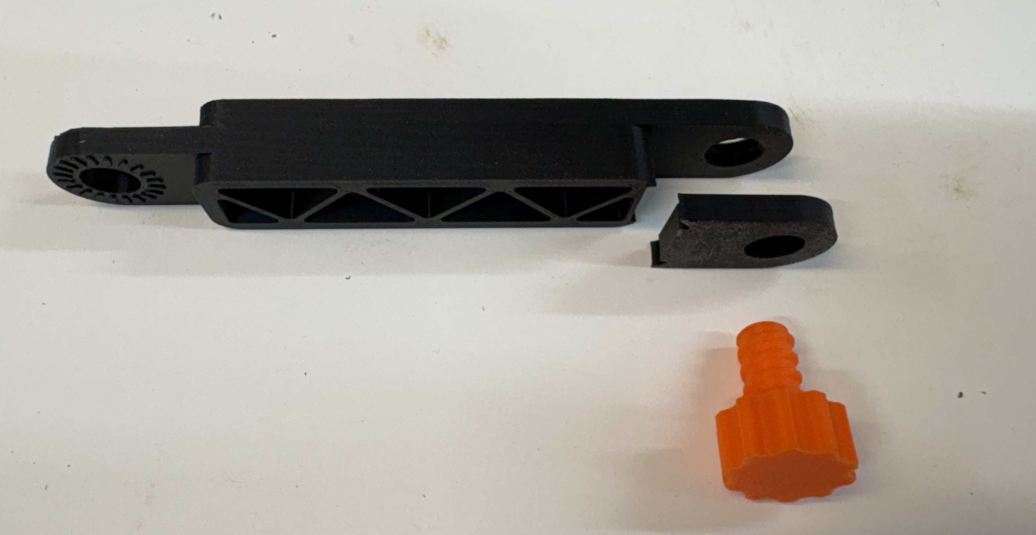
Step 11: Prepare 3D printed parts C, D, and F as shown below on the left. Place parts C and D over the upright section of part A and thread the screw through the holes. Make sure part D locks into the boom arm and that the rough side of part D is against the rough side of part A.
C
D

Slide 10
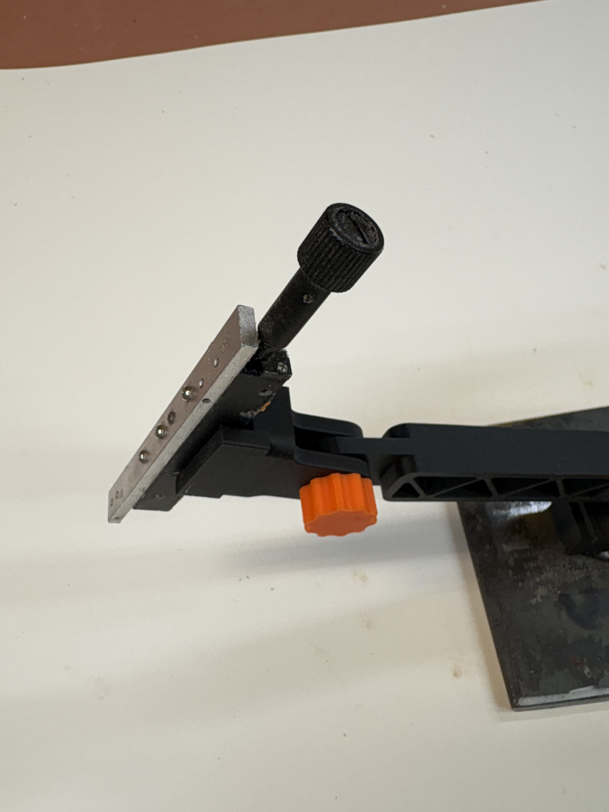
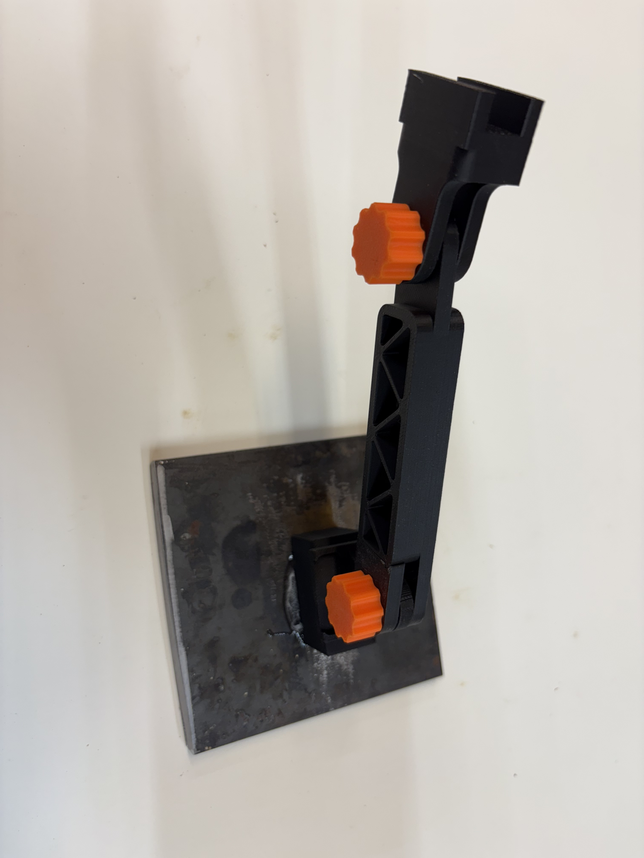
Step 12: Slide 3D printed part B over the end of the boom arm (part C) and thread the second screw (F) through the holes.
Step 13: Glue one of the y-axis components into the slot in part B. Be careful not to get glue into the mechanism

Slide 11
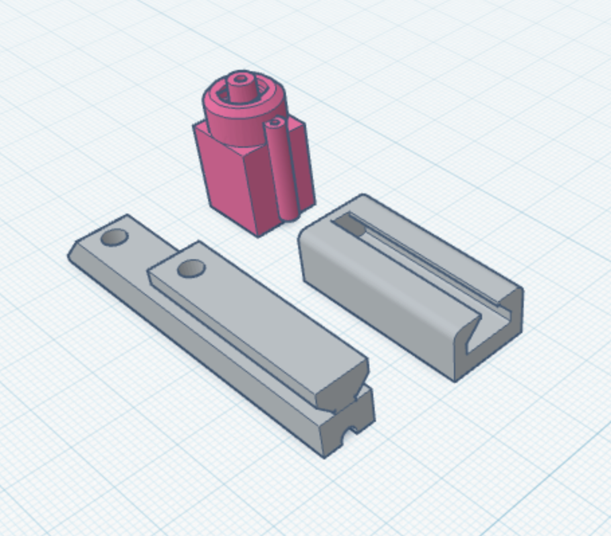
Assemble the Wire Electrode
Step 14: Glue Part A to the top of the silver x-axis from Step 13. Make sure the slot in part A faces up.
C
Step 15: Slide the triangular dovetail from part B into the slot in part A
A
B
Step 16: Glue part C to the upper end of part B with the luer lock facing away from part A.

Slide 12
Step 17: Insert the dispensing syringe needle into the luer lock from step 16.
Step 18: Use fine sandpaper to remove the coating from one end of the coated copper wire.
Step 19: Carefully insert a 5-6 inch piece of coated copper wire into the metal needle until it sticks out the back of the electrode holder part C
Step 20: Solder the newly sanded end of the electrode wire to the red wire of the audio jack and secure the wires to the plastic holder with glue or blue dental wax.
Step 21: Solder a 5-6 inch piece of bare copper wire to the end of the black wire on the audio jack and cut off the white wire (it is not used). Slide the bare wire through the small tube (or into the small groove) on the outside of the plastic electrode holder and secure it with glue. This will serve as the reference electrode.

